Slide 1

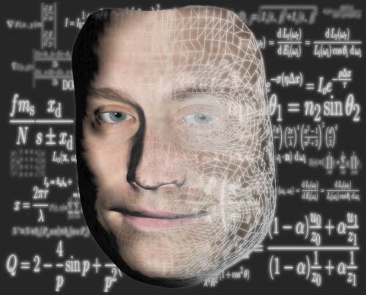
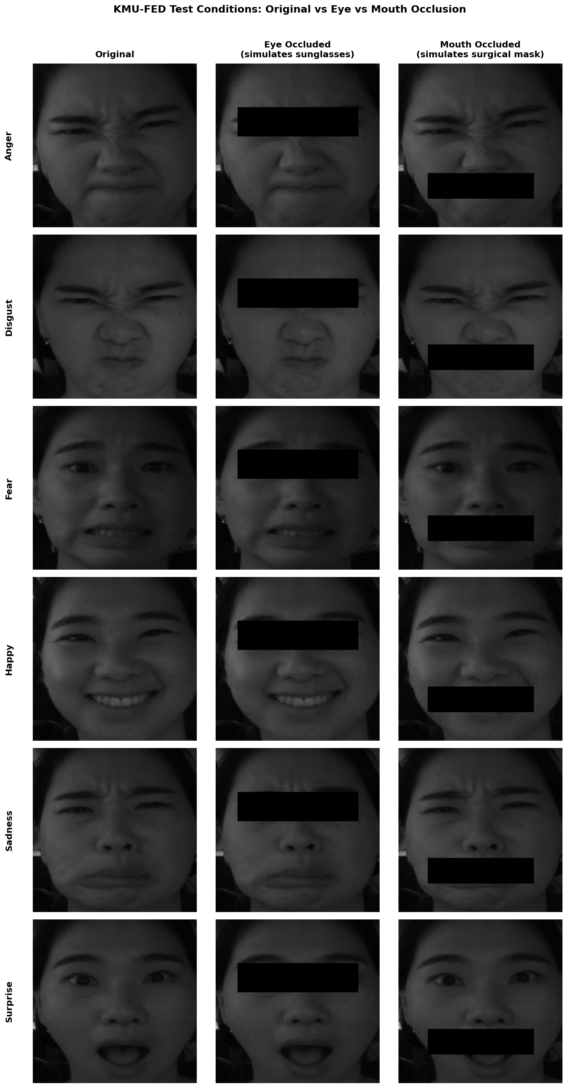
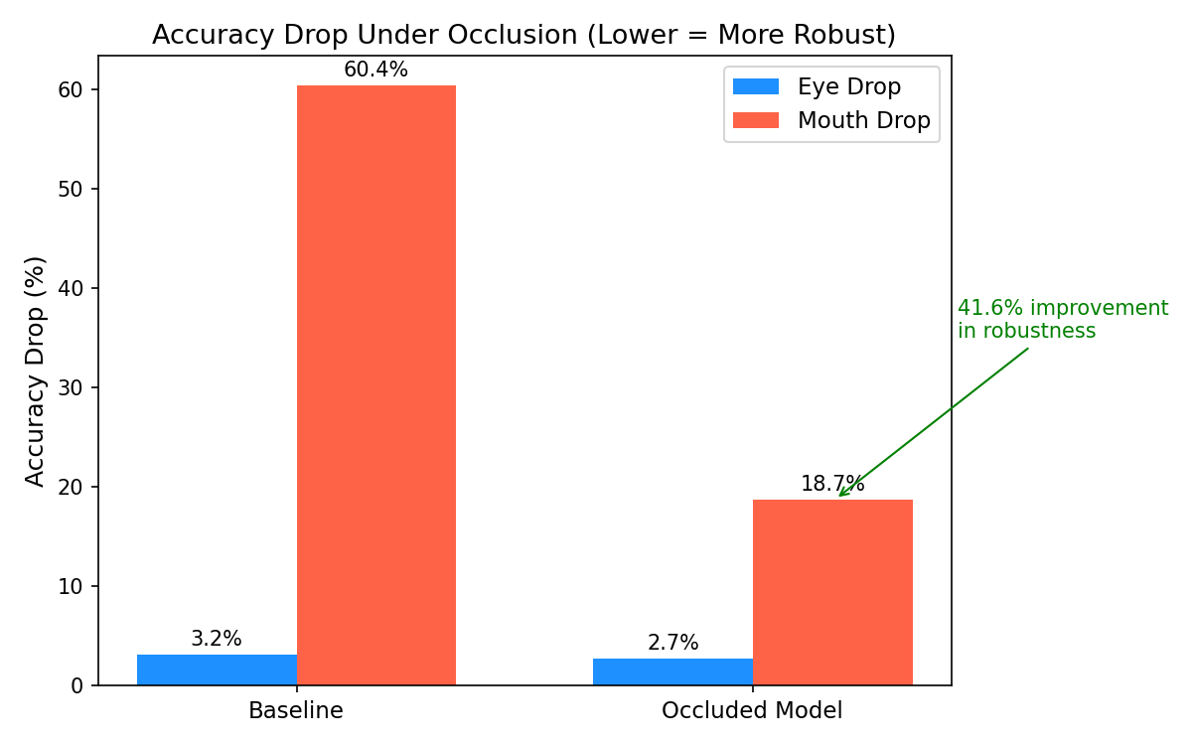
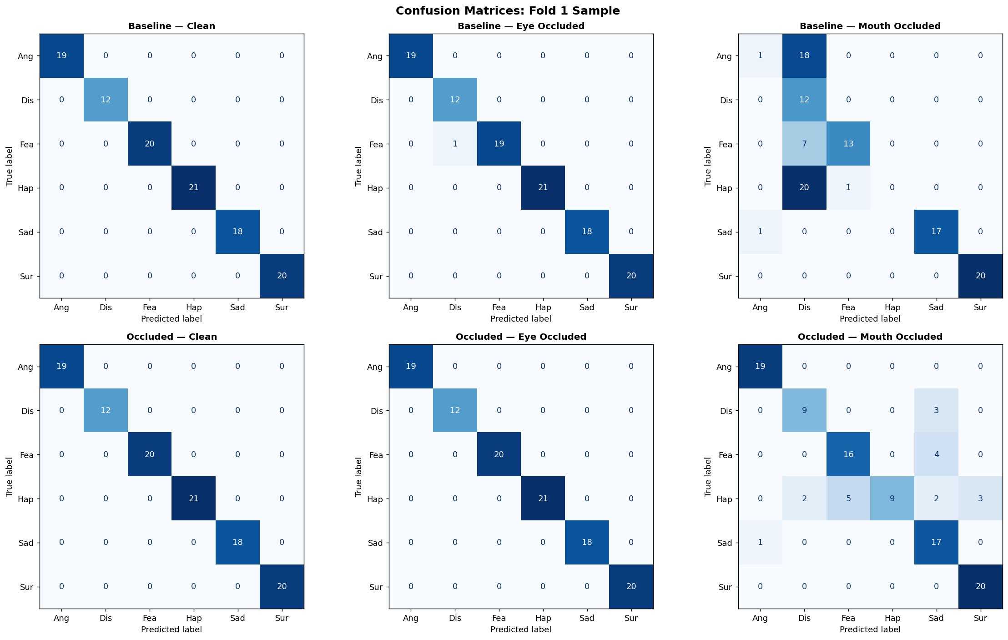
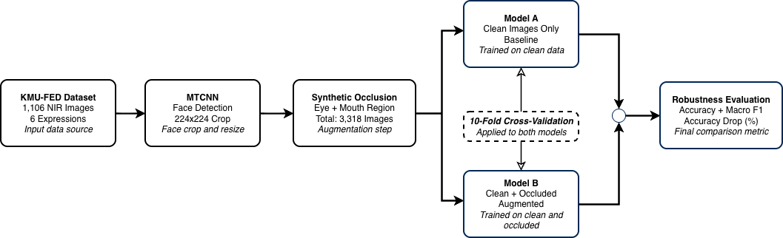
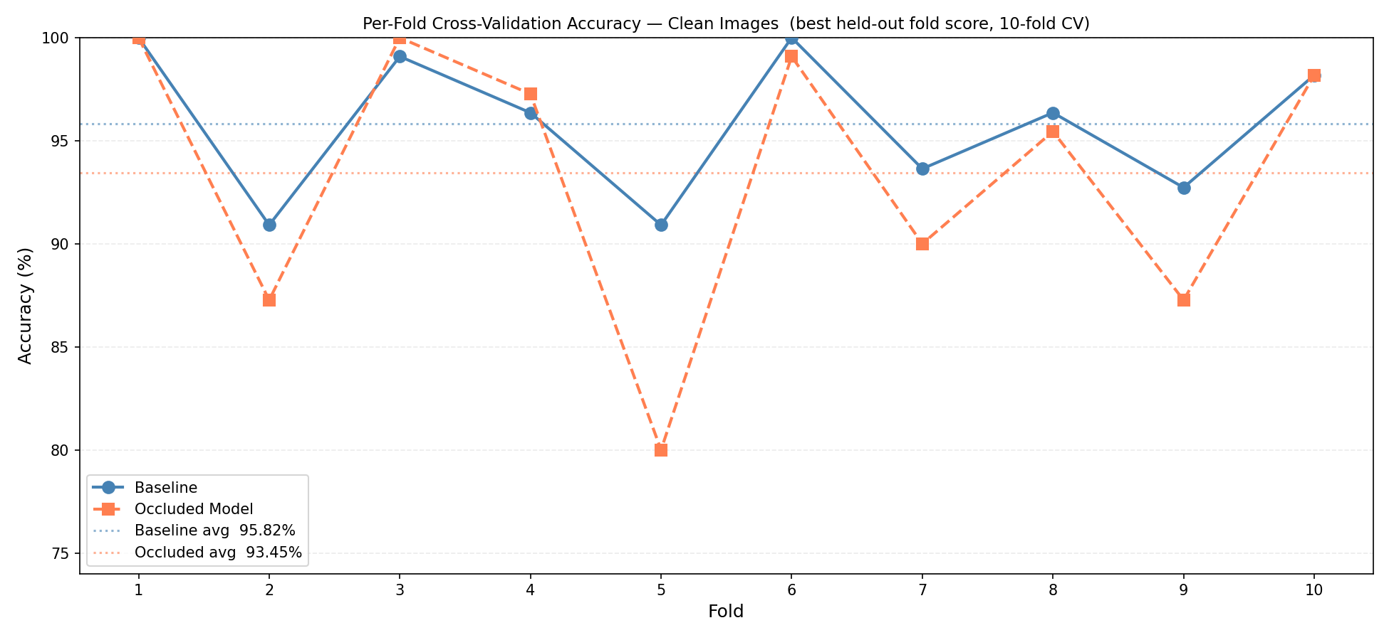
Does DFER-GCViT Hold Up Under Real-World Occlusions?
A Robustness Study Using Synthetic Occlusions on KMU-FED
Srimonchaari Padmanabhan Babu, Ibtissam Saadi, Douglas W. Cunningham
Department of Graphical Systems, BTU Cottbus-Senftenberg, Cottbus, Germany
1. INTRODUCTION
4. RESULTS
Gap: Driver facial expression recognition, including DFER-GCViT (Saadi et al., 2023) at 98.27% on KMU-FED [1], has never been verified under real-world occlusions [1].
Why it matters: Grad-CAM confirms heavy reliance on the mouth region [1], which is vulnerable to masks and sunglasses.
This study: synthetic occlusions applied to KMU-FED [3]. Robustness measured via accuracy drop (%).
Test Condition | Model A (Baseline) | Model B (Occluded)
Clean | 95.82% | 93.45%
Eye Occluded | 92.64% | 90.73%
Mouth Occluded | 35.45% | 74.73%
Eye Drop | 3.18% | 2.73%
Mouth Drop | 60.36% | 18.73%
Model A relies almost entirely on the mouth: 60.36% accuracy drop vs. just 3.18% for eye occlusion. Model B recovers most of that loss, cutting the mouth-occlusion drop from 60.36% to 18.73%.
Fig. 1. Mouth occlusion erases the signal the baseline model depends on, the root cause of its 60% accuracy drop.
2. RESEARCH QUESTIONS
Fig. 4. Accuracy drop (%) under occlusion. Mouth occlusion drops Model A's accuracy by 60.36 percentage points, reduced to 18.73 with occlusion training, a 41.6-point recovery. Eye occlusion has minimal effect on both models.
RQ1: How much does DFER-GCViT accuracy and F1-score drop under synthetic occlusion at test time?
RQ2: Can training with occluded samples reduce that performance gap?
3. METHODOLOGY
Step 1, Baseline (Model A): pretrained GC-ViT Base [2] with the modified classifier head from Saadi et al. [1], evaluated with 10-fold CV on KMU-FED [3].
Step 2, Occlusion: black rectangles placed over the eye (simulating sunglasses) and mouth (simulating a surgical mask), applied programmatically with no manual labelling.
Step 3, Training: Model A trains on clean images only. Model B trains on 50% occluded images (25% eye, 25% mouth), using the same held-out folds.
Step 4, Evaluation: both models (A and B) are tested on three conditions, clean, eye-occluded, and mouth-occluded, using accuracy drop (%) as the robustness metric.
Fig. 5. Confusion matrices under mouth occlusion. Model A (baseline) confuses Anger and Happy with Disgust; Model B (occluded training) stays mostly on the diagonal.
5. CONCLUSION
Mouth occlusion is catastrophic for Model A: expressions driven by mouth signals (Happy, Surprise, Anger) fail completely.
Model B cuts the mouth-occlusion drop from 60.36% to 18.73%, while clean accuracy drops slightly from 95.82% to 93.45%.
GC-ViT global attention makes both models resilient to eye occlusion. Mouth remains the critical vulnerability.
Fig. 2. Testing eye and mouth occlusion separately reveals exactly which region the model relies on.
6. FUTURE WORK
• Test with real occlusion data, using subjects wearing actual sunglasses and surgical masks during recording.
• Multi-modal fusion combining facial expression recognition with audio and physiological signals.
• Real-time deployment on embedded in-vehicle systems.
Fig. 3. Per-fold cross-validation accuracy on clean images. Both models perform comparably baseline averages 95.82%, occluded model 93.45% - though the occluded model is less stable, dropping to 80% in fold 5.
References:
[1] I. Saadi, D. Cunningham, A. Taleb-Ahmed, A. Hadid, Y. El Hillali, "Driver's Facial Expression Recognition using Global Context Vision Transformer," IEEE CVMI, 2023.
[2] A. Hatamizadeh, H. Yin, J. Kautz, P. Molchanov, "Global Context Vision Transformers," arXiv:2206.09959, 2022.
[3] M. Jeong, B. C. Ko, "Driver's facial expression recognition in real-time for safe driving," Sensors, vol. 18, no. 12, p. 4270, 2018.
Contact: padmasri@b-tu.de

